Slide 1
Understanding H1N1 Flu and the Global Vaccination Response Presentation
By John Njogu

Slide 2
Project analysis slide 2
Project Analysis
Business Understanding
Data Understanding
PROJECT
Data Preparation
Evaluating and Testing
Modelling

Slide 3
Background
H1N1, also known as swine flu, is a type of influenza A virus that originated in pigs.
In 2009, the virus mutated, enabling human-to-human transmission — even among people with no contact with animals.
The disease spread globally, and by June 2010, over 214 countries had confirmed cases, leading to 18,239+ deaths.
In response, the World Health Organization declared H1N1 a pandemic in August 2010.
Massive vaccination campaigns were launched to curb the spread and protect populations.
Despite global efforts, vaccine uptake varied, influenced by behavioral, social, and informational factors.

Slide 4
Project analysis slide 3
Stakeholder Analysis
Public health agencies (e.g., CDC, WHO)
Policy makers
Healthcare providers
Epidemiologists and researchers
Non-profit organizations
seeking data-driven guidance for pandemic preparedness
.
planning outreach and education programs
.
studying vaccine hesitancy and uptake
involved in community health campaigns
Aiming to improve vaccination strategies
.

Slide 5
Objective
Problem statement
This study aims at developing a predictive model that estimates the probability that individuals received the H1N1 and seasonal flu vaccines based on their demographic attributes, health behavior, medical history, and personal opinions regarding flu and vaccination. With the goal being to identify patterns that can inform targeted interventions and enhance public health decision-making.

Slide 6
Project analysis slide 6
Data Understanding
The data was sourced from DrivenData. (2020). Flu Shot Learning: Predict H1N1 and Seasonal Flu Vaccines. Retrieved [July 18 2025] from https://www.drivendata.org/competitions/66/flu-shot-learning. The data was collected through a phone survey in the United States asking respondents whether they had received the H1N1 and seasonal flu vaccines, in conjunction with questions about themselves. The other additional questions covered their social, economic, and demographic background, opinions on risks of illness and vaccine effectiveness, and behaviors towards mitigating transmission
.
- This dataset has 26707 unique Ids representing the individual respondents
- The data has a 36 columns of a mixture of integers, floats and object types
- 24 of the columns are numeric while 12 columns are non-numeric
- There are some columns with some missing values
- The all of the columns in this dataset apart from the respondent id column seem to be either behavioral or demographics data.

Slide 7
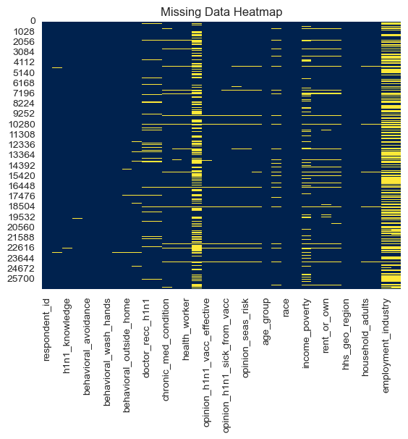
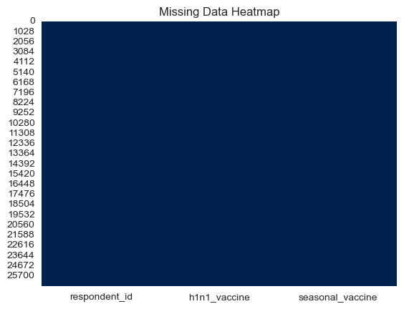
Project analysis slide 5
Data Cleaning

Slide 8
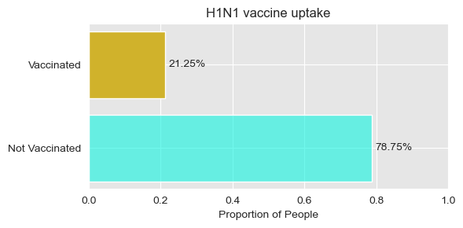
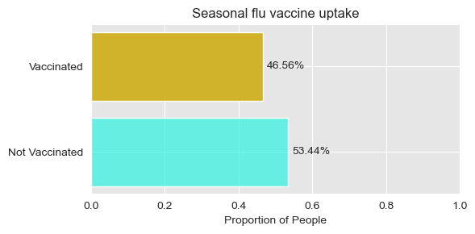
Project analysis slide 7
Review of the target columns
Review of target columns hinted to a class imbalance

Slide 9
Project analysis slide 8
Data processing
REMOVING
GROUPING
REMOVING
GROUPING
Dropping the respondent ID since it has no useful information necessary for modelling
Grouping the columns into two types numeric and categorical
PROCESSING
ENCODING
DEFINING
Perform OneHotEncoding on the categorical columns
Define our X features and our target
DATA

Slide 10
Project analysis slide 10
Modelling and Evaluation
Model Accuracy Precision Recall F1-Score ROC AUC 0
model_4 0.837888 0.659549 0.489868 0.562184 0.829807 1 model_1 0.835829 0.674324 0.439648 0.532267 0.829216 2 model_2 0.770872 0.474292 0.723348 0.572924 0.829153 3 model_3 0.834519 0.688722 0.403524 0.508889 0.817517 4 model_5 0.756645 0.431193 0.455507 0.443016 0.646698
Hypertuned Random forest model
Hypertuned random forest – model 4
Baseline model – model 1
Hypertuned logistic regression model – model – model 2
Basic random forest model – model -3
Decision tree model- model
5
Hypertuned logistic model
Basic Random forest model
Decision Tree model

Slide 11
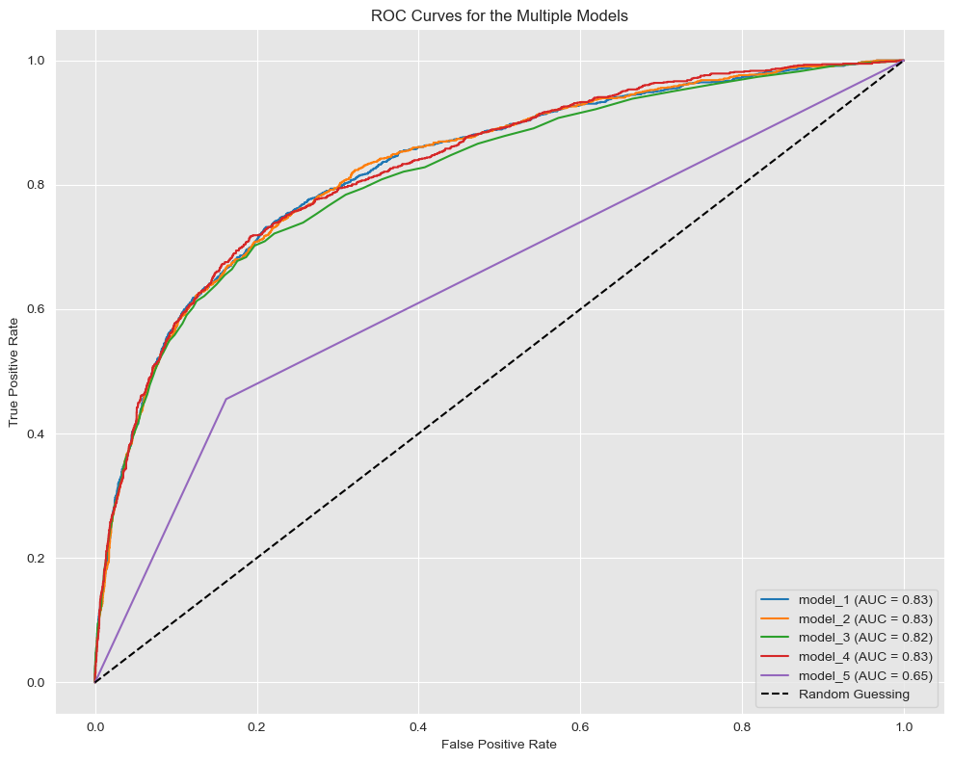

Slide 12
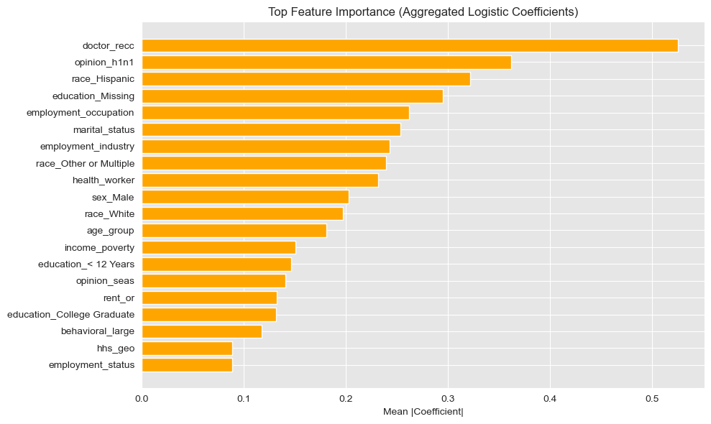
Feature importance

Slide 13
Findings
Among the models evaluated, Model 4—a Random Forest Classifier—achieved the highest overall performance with a ROC-AUC score of 0.8298. However, despite this strong performance on the overall classification curve, it had a relatively low recall of 0.49 for the positive class (vaccinated individuals), indicating limited sensitivity in identifying those who actually received the vaccine.
Close behind was Model 1, the baseline Logistic Regression, with a ROC-AUC of 0.8292, though it exhibited a low F1 score, suggesting challenges in generalizing to unseen data.
Notably, Model 2, the hyperparameter-tuned Logistic Regression, demonstrated the highest F1 score (0.5729) and the best recall (0.72) for the vaccinated class. While its precision was lower at 47%, this model offers a more favorable trade-off between recall and precision, especially in contexts where false negatives (missing vaccinated individuals) are more costly than false positives.
Overall, if high recall is prioritized—such as in public health screening where identifying as many unvaccinated individuals as possible is critical—Model 2 emerges as the most suitable choice despite not having the highest overall accuracy or ROC-AUC. Thats because It’s safer to assume someone is not protected and try to reach them.

Slide 14
Recommendations
We recommend using the hyperparameter-tuned Logistic Regression model (Model 2) for predicting H1N1 vaccination uptake. Although it does not have the highest ROC-AUC score overall, it achieves the highest recall (72%) among all models—making it especially valuable in public health contexts where identifying as many unvaccinated individuals as possible is critical.
This model also offers a balanced trade-off between precision (47%) and recall, as reflected in its highest F1 score (0.573), indicating better generalization than other classifiers.
We recommend that vaccination drives / campaigns look into the following attributes because they are highly correlated with vaccine uptake
- Doctor_recc (doctor recommendation) - Patients often trust their healthcare providers and are more likely to get vaccinated if explicitly advised to do so.
- opinion_h1n1 (perception of vaccine effectiveness) - Personal belief in the effectiveness or safety of the H1N1 vaccine directly influences willingness to get vaccinated. Positive attitudes usually correlate with higher uptake.
- race_Hispanic and race_Other or Multiple - Differences in cultural beliefs, access to healthcare, and targeted public health campaigns may cause variations in vaccine uptake across racial/ethnic groups.
- education level, employment factors, and marital status - Missing education data may correlate with lower socioeconomic status or limited health literacy—both linked to vaccine hesitancy or access issues.
Industry - Different industries/ companies have varying exposure risks and workplace vaccination policies that may enhance or impede vaccination targets.
More data on education and environmental factors may give a clearer light on access and underlying patterns

Slide 15
Q/A?

Slide 16
Thank You

